Slide 1




HOLIDAYS;
Valentine’s Day

Slide 2






Try to solve this: https://wordwall.net/resource/10721665
Are you in love?
Remember the words you already know about Valentine’s Day . You can write them in the notebook or use the tool CREATE NOW on: https://wordart.com/
roses
hearts
love
VALENTINE’S DAY
When do we celebrate Valentine’s Day?

Slide 3
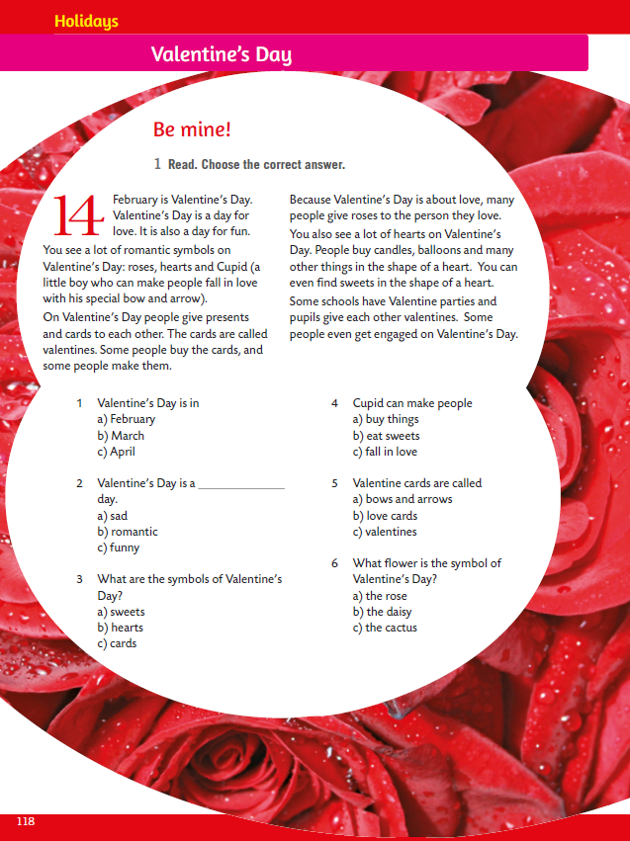
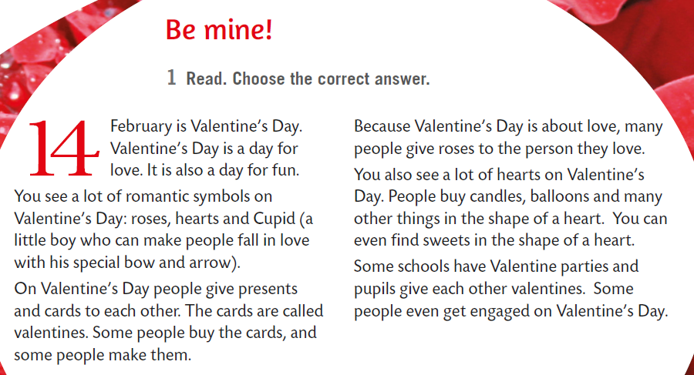
Open your book, page 118.
Read the text.

Slide 4

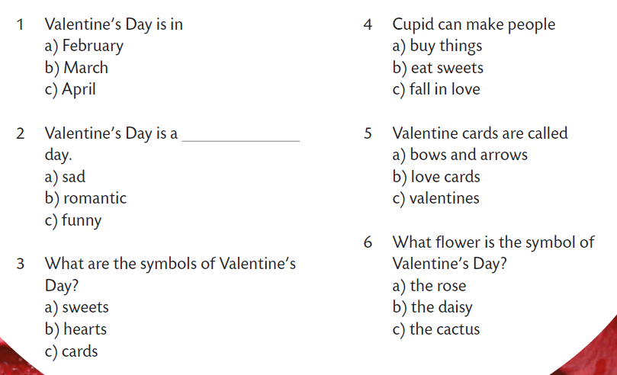

Choose the correct answer.
Practice herei! https://wordwall.net/resource/10722581

Slide 5

Use the tool on the link to make a Valentine card: https://www.canva.com/design/play?category=tACVL2ns1Zw&referrer=ecards-landing-page&utm_source=onboarding

